Slide 1
Artificial Intelligence

Slide 2
Search Strategies
Blind (Un-informed) Searches
We wonder in the search space without any clue where the goal could be
Heuristic (Informed) Searches
Heuristic function guides us whether we are getting near or far from the goal
Adversarial Searches
When two agents have conflicting goals, such as in playing games

Slide 3
Blind Search Strategies
Blind (Uninformed) search strategies use only the information available in the problem definition
They don’t have any additional information about a state beyond that is provided in the problem definition.
Breadth-first Search
Depth-first search
Uniform-cost search
Iterative deepening search
Notes:
They don’t have any additional information about state beyond that is provided in the problem definition.

Slide 4
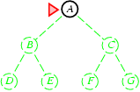
Breadth-first Search
Expand shallowest node first, i.e., nodes visited 1st shall be expanded 1st
Implementation:
Can be implemented by calling Tree-Search algo
use the fringe(first node) as a Queue, FIFO
Put the newly expanded node at the back of the frontier
Frontier = A

Slide 5
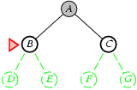
Breadth-first Search
Check if A is goal, it is not, expand A, remove A
Fringe = B,C

Slide 6
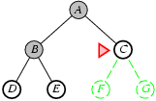
Breadth-first Search
Check if B is goal, it is not, expand B, remove B
Fringe = C, D, E
Check if C is goal, it is not, expand C, remove C
Frontier = D, E, F, G

Slide 7
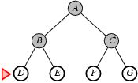
Breadth-first Search
Expand shallowest unexpanded node Check if D is goal, it is not, no children so remove D
Fringe = E, F, G
Search goes on until goal is found. Once it is found, the search terminates

Slide 8
Properties of Breadth-first Search
Complete: Yes
Optimal: Yes
Time: O(b^{d})
B= branch factor
D = depth
e.g
B=3
D=2
3^2=9 searches
Notes:
Space is a bigger problem than cost
d is the depth of the lowest cost solution

